Slide 1
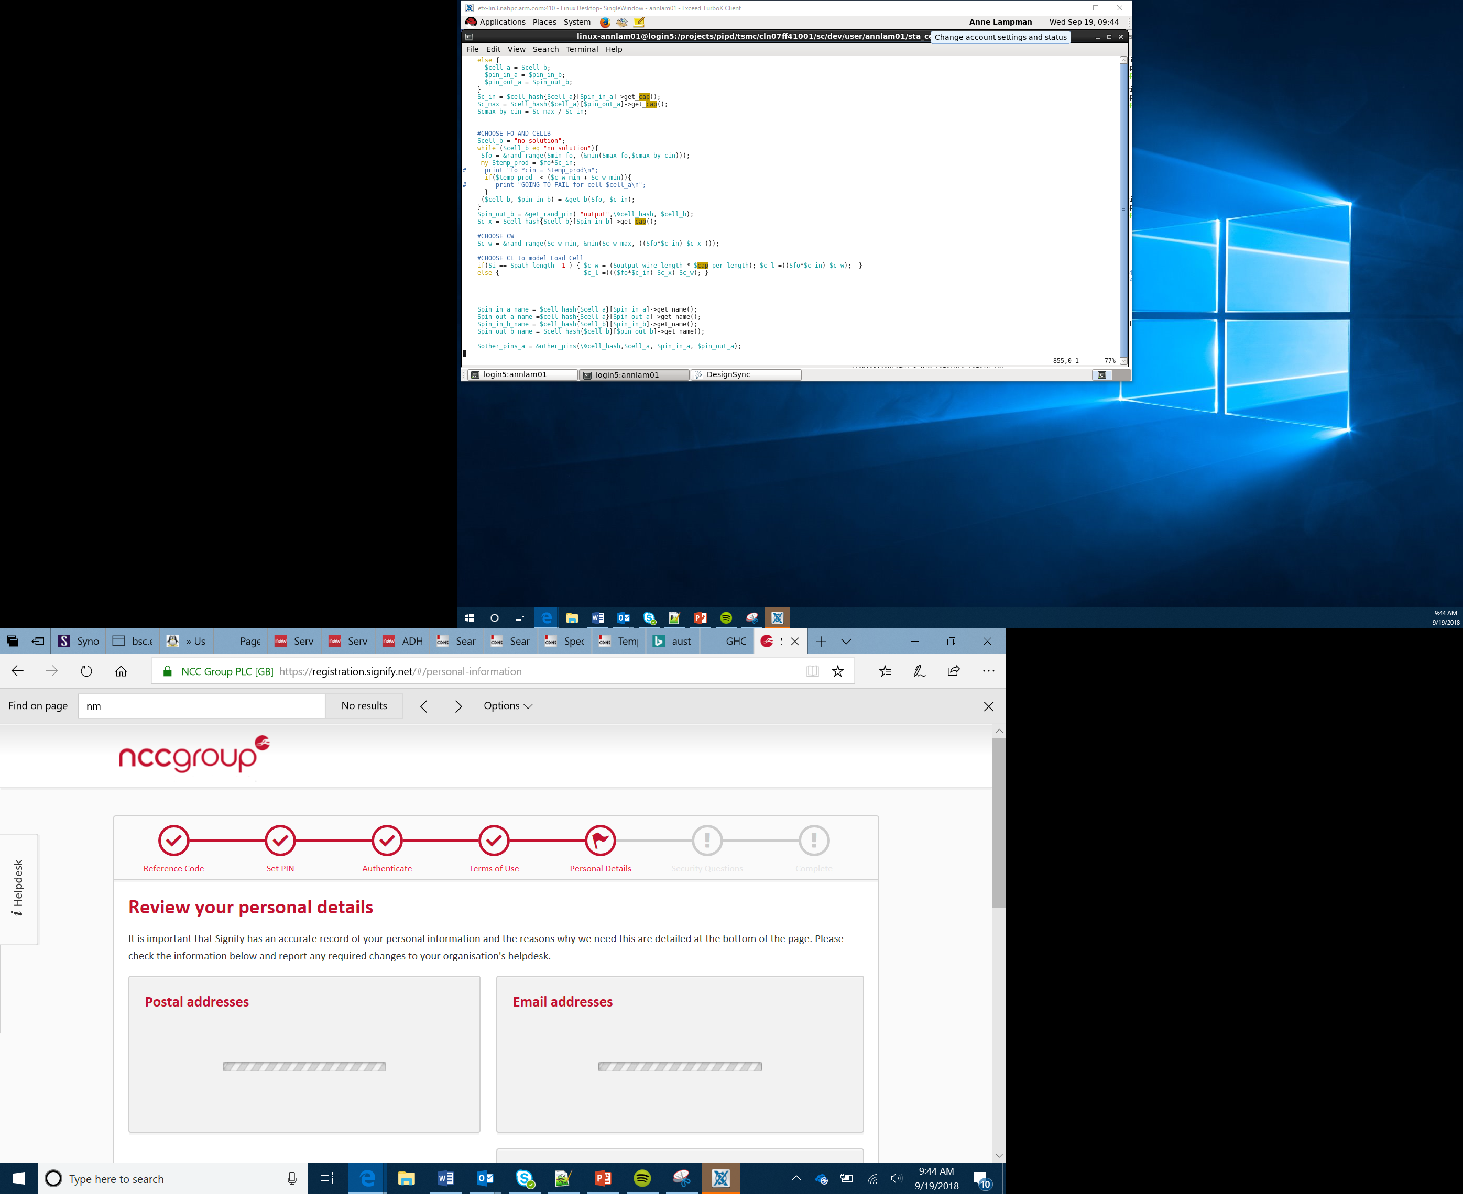

Project – Healthy Eating Quiz Machine
Lesson 6
Testing and Evaluation

Slide 2
Success Criteria
The product must:
Have a display that the micro:bit is embedded in
Be robust enough to be played with
Contain a micro:bit that users can interact with
Use the buttons to input answers
provide some feedback to the user, a score, some advice, a food to eat
Notes:
Discuss that the micro:bit has a number of pins, can the students locate them? Talk over some of the pins and what they do, the GND pin, power pins, input and output pins.

Slide 3
Getting Started
Healthy eating and exercise are an import part of children lives.
You have been tasked with creating a digital quiz that asks students about what they eat.
They answer a question or questions and the program tells them a score, or a piece of advice, or a food to eat.
Notes:
Introduce the project.

Slide 4
Pro-tip
Plan the questions, answers and responses first before you start building your program. This will support you to use the correct selection code and responses.
Question 1 – Do you drink more than two cans of pop a day?
A = Yes B = No
Response A = Sad face
Response B = Smile

